Slide 1
Concurrency
Q2, 2016

Slide 2
Recap from last week
Bakery lock
First-come-first-served and r-bounded waiting
Lower bound on number of read/write registers for constructing lock.
Linear time temporal logic
Transition systems
F, G, X

Slide 3
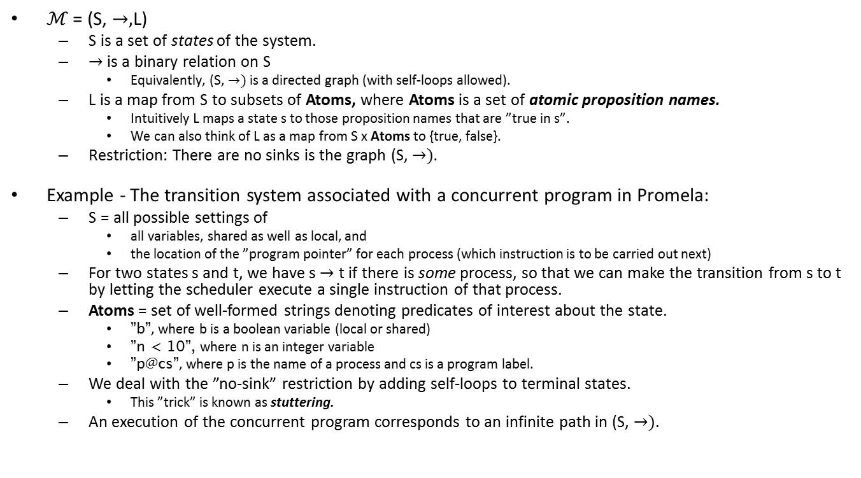
A transition system (LCS, Def 3.4)
ℳ = (S, $→,$L)
S is a set of states of the system.
$→$ is a binary relation on S
Equivalently, (S, $→)$is a directed graph (with self-loops allowed).
L is a map from S to subsets of Atoms, where Atoms is a set of atomic proposition names.
Intuitively L maps a state s to those proposition names that are ”true in s”.
We can also think of L as a map from S x Atoms to {true, false}.
Restriction: There are no sinks is the graph (S, $→).$
Example - The transition system associated with a concurrent program in Promela:
S = all possible settings of
all variables, shared as well as local, and
the location of the ”program pointer” for each process (which instruction is to be carried out next)
For two states s and t, we have s $→$ t if there is some process, so that we can make the transition from s to t by letting the scheduler execute a single instruction of that process.
Atoms = set of well-formed strings denoting predicates of interest about the state.
”b”, where b is a boolean variable (local or shared)
”n < 10”, where n is an integer variable
”p@cs”, where p is the name of a process and cs is a program label.
We deal with the ”no-sink” restriction by adding self-loops to terminal states.
This ”trick” is known as stuttering.
An execution of the concurrent program corresponds to an infinite path in (S, $→)$.

Slide 4
A Promela program and its transition system
int m = 0;
active proctype p(){
m = 1
}
active proctype q(){
m = 2
}
m==0
m==1
m==2
m==2
m==1
Note that the transition system represents the entire concurrent program (all threads), not just an individual thread.

Slide 5
LTL – semantics
A path π = s₁ → s₂ → s₃ → … in a transition system ℳ is defined to satisfy LTL formulas as follows:
π ⊨ p iff the predicate corresponding to p is true at s₁.
π ⊨ p ∧ q iff π ⊨ p and π ⊨ q
…. similarly for the other propositional operators
π ⊨ Fφ iff ∃i≥1. π^{i} ⊨ φ
π ⊨ Gφ iff ∀i≥1. π^{i} ⊨ φ
π ⊨ Xφ iff π² ⊨ φ
We will add the definition for U,W,R a little later….
The path s_{i} → s_{i+1} → s_{i+2} → …

Slide 6
Temporal Tautologies
A temporal tautology is an LTL formula φ so that for all transitions systems ℳ we have that ℳ⊨φ.
Also known as theorem or law of temporal logic.
Example:
(FG Α ∧ FG Β) → FG(Α∧Β)
Temporal tautologies can be proved by refering back to the semantics of the formula, arguing explicitly about time lines.
Once we have a “library” of temporal tautologies, they allow us to do “semi-formal” reasoning about temporal properties

Slide 7
Semantic equivalences
Definition 3.9 (LCS): Two LTL formulas φ and ψ are said to be semantically equivalent, and we write φ≡ψ, if and only if φ ↔ψ is a temporal tautology.
Example: ¬ Gφ ≡ F¬φ
Semantic equivalences allow us to cut back on the number of temporal operators we consider.

Slide 8
Until
p U q
Read ”p-until-q”
Eventually q becomes true and p is true until that happens (after being true, q might become false again).
Augmenting the formal semantics:
π ⊨ φUψ iff ∃i≥1. ( π^{i} ⊨ ψ and ∀1≤j<i, π^{j} ⊨ φ)

Slide 9
Embedded systems example
At any point in time, if the elevator is at the second floor and moving upwards, and people are waiting at the fifth floor, the elevator will not change direction until it has been at the fifth floor (and it will actually get there).
□( ((floor==2) ∧ (direction==up) ∧ button5pressed) → ((direction==up) U (floor==5)))

Slide 10
Expressing G and F in terms of U
F p is semantically equivalent to T U p
G p is semantically equivalent to ¬(T U ¬p)
… but U cannot be expressed in terms of the operators previously introduced.

Slide 11
Weak-Until
p W q
Read ”p-weakly-until-q”
p is true until the first time in the future that q is true – if this never happens, p is always true.
Augmenting the formal semantics:
Just view p W q as a shorthand for (p U q) ∨ Gp.

Slide 12
p-Releases-q
p R q
Read ”p-releases-q”
q will remain true up to and including the moment when p becomes true. If p never becomes true then q stays true for ever.
p R q is semantically equivalent to ¬(¬p U ¬q)
Exercise: Prove this!
We can also take this as its formal semantic definition.

Slide 13
U, R and W
p W q is semantically equivalent to ¬(¬q U (¬p ∧¬q))
p R q is semantically equivalent to ¬(¬p U ¬q)
p U q is semantically equivalent to ¬(¬p R ¬q)
p W q is semantically equivalent to q R (p∨q)
p U q is semantically equivalent to ¬(¬q W (¬p ∧¬q))
p R q is semantically equivalent to q W (p∧q)

Slide 14
Next: Promela and Spin
Promela
A modeling language for concurrency.
Think of a Promela program (or Promela model) as a specification of a transition diagram.
Spin
A tool for analyzing Promela models, e.g.
Does the model satisfy LTL formula ϕ?

Slide 15
Promela variables and processes
ltl { <>[](m==1) }
int m = 0;
active proctype p(){
m = 1
}
active proctype q(){
m = 2
}
Is the LTL formula a correct statement
about the program?
A: Yes
B: No
C: I don’t know

Slide 16
Promela variables and processes
ltl { <>(m==1) }
int m = 0;
active proctype p(){
m = 1
}
active proctype q(){
m = 2
}
Is the LTL formula a correct statement
about the program?
A: Yes
B: No
C: I don’t know

Slide 17
Promela variables and processes
ltl { <>[](n==2) }
int n = 0;
active proctype p(){
n = n + 1;
}
active proctype q(){
n = n + 1;
}
Is the LTL formula a correct statement
about the program?
A: Yes
B: No
C: I don’t know

Slide 18
Atomic statements
ltl { <>[](n==2) }
int n = 0;
active proctype p(){
n = n + 1;
}
active proctype q(){
n = n + 1;
}
Unlike in java, each Promela statement is carried out atomically – i.e., corresponds to a single transition in the transition system

Slide 19
Atomic construction
int n = 0;
ltl { <>[](n==2) }
active proctype p(){
int tp;
atomic{tp = n; n = tp + 1};
}
active proctype q(){
int tq;
atomic{tq = n; n = tq + 1};
}

Slide 20
Promela Process model
At any state, each process is either enabled or blocked.
”Between states”, during a transition, exactly one process is running.
A blocked process is not allowed to move its control pointer and the scheduler will ignore it.
This is conveniently similar to the java process model.
A blocked process is unblocked when some boolean condition becomes true.
More flexible than in java
In terms of the transition system, a process that is blocked at a state simply has no outgoing transition from that state.

Slide 21
Promela selection and blocking
if
:: (a != b) -> option1
:: (a == b) -> option2
fi
Option 1 is executed if a is not equal to b. Otherwise option 2 is executed.
if
:: (a != b) -> option1
:: else -> option2
fi
Same behavior
if
:: (a == a) -> option1
:: (a == a) -> option2
fi
Either option 1 or option 2 is executed. Which one is nondeterministically chosen, i.e. both transitions are possible.
if
:: (a != a) -> option1
:: (a != a) -> option2
fi
The process is blocked until one of the conditions become true (in this case, it will be blocked forever).

Slide 22
Promela repetition
do
:: (a != b) -> option1
:: (a == b) -> break
od
while (a!=b) { option1 }
do
:: (a != b) -> option1
:: else -> break
od
Same thing

Slide 23
Live AMP-relevant verification and falsification demo
LockOne and LockTwo from AMP, Chapter 2
Both satisfy mutual exclusion
Neither satisfy starvation freedom
Let’s make Spin establish these facts!

Slide 24
Weakly fair executions
An execution is said to be weakly fair, if it is not the case that the system after some point fails to move a process forward forever even though that process is enabled at every time step after than point.
To formalize this, let us assume that we for each process p have atoms
Enabled(p), which is true in states where it is possible for p to move its program counter (p is neither blocked nor terminated).
Moved(p), which is true in states where we actually just moved p’s program counter – I don’t think we have this built into Promela, which is a bit annoying; it would be a nice addition! The reason probably is that including it increases the size of the state space (why?)
Not weakly fair for p: F G (Enabled(p) ∧ ¬ Moved(p))
Spin has an option to only check the validity of a LTL formula on weakly fair executions.
pan –a –f
It most situations, you want to use this option….
Exception: Verification of resilience to crash failures.
Not strongly fair for p: (G F Enabled(p)) ∧ (F G ¬ Moved(p))
Not being strongly fair is a weaker(!) (more permissive) property than not being weakly fair.
In a not-strongly-fair execution, the system at some point stops moving p forward forever, even though there are infinitely many points in time where it could move p forward.
If you only want to consider such executions, you can ”simulate” Moved by adding a single boolean ”help variable” to your Promela program. See exercises next week.

Slide 25
Under the hood of the Spin tool
The Vardi-Wolper algorithm (1986)
Input: A formula φ in linear-time temporal logic and a transition system ℳ.
Output: Does ℳ satisfy φ? If not, a description of an execution (i.e., path) of ℳ that falsifies φ.
Running time: O(4^{|φ|}|ℳ|)
The VW-algorithm: dADS meets dRegAut meets dBerLog meets dConc meets dKombSoeg.

Slide 26
Spin tool
S
The VW algorithm
dBerLog provides background
concepts for defining this
LTL formula φ
Transition system M
dRegAut provides background concepts AND conversion technique
Büchi automaton
Directed graph G
dADS provides linear time algorithm for this
Strongly connected components of G
The answer
dConc provides important application area for the algorithm/tool
A: YES!
Q: Is Peterson’s algorithm for mutual exclusion starvation free?
But there is more!

Slide 27
Under the hood of the Spin tool
The Vardi-Wolper algorithm (1986)
Input: A formula φ in linear-time temporal logic and a transition system ℳ.
Output: Does ℳ satisfy φ? If not, a description of a scenario of ℳ that falsifies φ.
Running time: O(4^{|φ|}|ℳ|)
Assuming P different from NP, this time bound cannot be improved to O(|φ|^{c} |ℳ |) for a constant c by any correct algorithm.
dKombSoeg

Slide 28
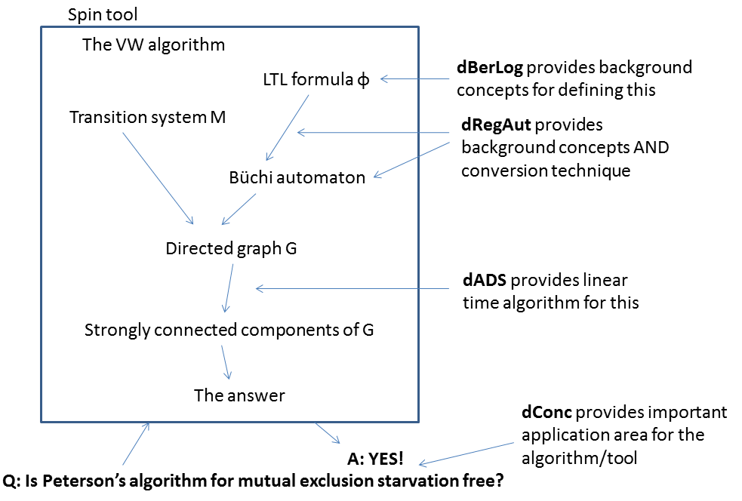
Plan
Büchi automata
Converting LTL formula into Büchi automata, setup and examples
Algorithmically deciding if some path of transition system ℳ is accepted by Büchi automaton A.
The general method for converting LTL formula into Büchi automata.

Slide 29
ω-words and ω-languages
Let Σ be a finite alphabet.
An infinite sequence x₁x₂x₃… with each x_{i} in Σ is called an ω-word.
The set of all ω-words is called Σ^{ω}.
Do not confuse this with Σ*, the set of all finite words over Σ.
A subset L of Σ^{ω} is called an ω-language.

Slide 30
Some ω-languages over {0,1,2}
The language L₁ of ω-words with “1” appearing in all even positions.
01210101212121… is in L₁.
001122001122001… is not in L₁.
The language L₂ of ω-words with “1” occurring infinitely many times.
012010101010101… is in L₂.
012020202020202… is not in L₂.
The language L₃ of ω-words with “1” occurring in all sufficiently high indexed positions.
010202010111111… is in L₃.
011101212121212… is not in L₃.
The language L₄ of ω-words so that for all occurrences of “1”, there is a subsequent occurrence of “2”.
1201020102010101021012… is in L₄.
210101010101010… is not in L₄.

Slide 31
Büchi automata
A Büchi automaton extends the notion of a finite automaton to infinite inputs.
A Büchi automaton recognizes an ω-language rather than an ordinary language.

Slide 32
Büchi automata
A Büchi automata is a tuple A=(Q,Σ,δ,q₀,F) where:
Q is a finite set of states.
Σ is a finite alphabet.
δ is a subset of QxΣxQ, called the transition relation.
q₀ is in Q and is the initial state.
F is a subset of Q, called the accepting states.
So far, this is exactly the definition of a non-deterministic finite automata.

Slide 33
Büchi automata
A Büchi automata is a tuple A=(Q,Σ,δ,q₀,F).
Let x be an ω-word. A run of x on A is a sequence of states q₀q₁q₂… so that for all i,(q_{i},x_{i},q_{i+1}) is in δ.
A run of x on A accepts x if there are infinitely many occurrences of states from F in the run.
The ω-language accepted by A is the set of ω-words x for which some run of x on A accepts x.

Slide 34
Which ω-language does this Büchi automaton recognize?
1
0,2
1
0,2
A: The language of ω-words with the letter ”1” appearing in all even positions.
B: The language of ω-words with the letter ”1” appearing in all sufficiently highly indexed positions.
C: The language of ω-words with the letter ”1” appearing in infinitely many positions.
D: The language of ω-words so that for all occurrences of the letter ”1”, there is a subsequenct occurrence of the letter ”2”.
E: I don’t know.

Slide 35
Which ω-language does this Büchi automaton recognize?
1,0
2
1
0,2
A: The language of ω-words with the letter ”1” appearing in all even positions.
B: The language of ω-words with the letter ”1” appearing in all sufficiently highly indexed positions.
C: The language of ω-words with the letter ”1” appearing in infinitely many positions.
D: The language of ω-words so that for all occurrences of the letter ”1”, there is a subsequenct occurrence of the letter ”2”.
E: I don’t know.

Slide 36
Which ω-language does this Büchi automaton recognize?
1
0,1,2
0,1,2
A: The language of ω-words with the letter ”1” appearing in all even positions.
B: The language of ω-words with the letter ”1” appearing in all sufficiently highly indexed positions.
C: The language of ω-words with the letter ”1” appearing in infinitely many positions.
D: The language of ω-words so that for all occurrences of the letter ”1”, there is a subsequenct occurrence of the letter ”2”.
E: I don’t know.

Slide 37
Which ω-language does this Büchi automaton recognize?
1
0,1,2
A: The language of ω-words with the letter ”1” appearing in all even positions.
B: The language of ω-words with the letter ”1” appearing in all sufficiently highly indexed positions.
C: The language of ω-words with the letter ”1” appearing in infinitely many positions.
D: The language of ω-words so that for all occurrences of the letter ”1”, there is a subsequenct occurrence of the letter ”2”.
E: I don’t know.

Slide 38
Plan
Büchi automata
Converting LTL formula into Büchi automata, setup and examples.
Algorithmically deciding if some path of transition system ℳ is accepted by Büchi automaton A.
The general method for converting LTL formula into Büchi automata.

Slide 39
From LTL formulas to Büchi automata
Given an LTL formula φ, let Σ_{φ} be the set of truth assignments to atoms of φ.
Example:
φ: □ (q → ◊p)
Σ_{φ} = {qp,qp,qp,qp}
Notation: qp is the assignment that assigns true to q and false to p, etc.
Let ℳ be a transition system. For a state s of ℳ, let (s) be the symbol in Σ_{φ} corresponding to the truth values of the atoms in state s.
The trail (π) of a path π = s₁ → s₂ → s₃ → … in ℳ is the ω-word (s₁) (s₂) (s₃)…

Slide 40
Theorem (Vardi and Wolper)
For any LTL formula φ, there is a Büchi automaton Büchi(φ) with alphabet Σ_{φ}, so that:
for all paths π in all transitions systems,
π ⊨ φ if and only if Büchi(φ) accepts (π)
Also, Büchi(φ) can be constructed in time O(4^{|φ|}) from φ.
We will show this later. First some examples!

Slide 41
□ p
p

Slide 42
◊□ p
p
p , p
p , p

Slide 43
□(q → ◊p)
pq, pq
pq, pq
pq
pq,pq, pq

Slide 44

Büchi(φ) for which φ?
p
p
p
p
p,p
A: T
B: ◊ (p ∧X◊p)
C: □(p →¬X◊p).
D: □(p →X□(p →¬X◊p)).
E: I don’t know

Slide 45
Büchi(φ) for which φ?
p
p
p
p
p
A: T
B: ◊ (p ∧X◊p)
C: □(p →¬X◊p).
D: □(p →X□(p →¬X◊p)).
E: I don’t know

